Slide 1
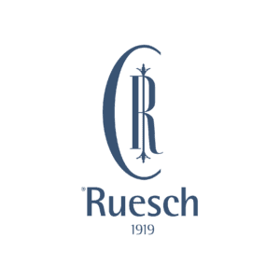

METABOLICALLY HEALTHY WEIGHT LOSS: SYNERGISTIC EFFECTS OF THE SWALLOWABLE BALLOON AND LOW-DOSE GLP-1 THERAPY ON MUSCLE MASS AND GLP-1 ADHERENCE
Dr. Luigi Flagiello, MD, Italy
University of Campania “L.Vanvitelli”- general and bariatric surgery
Ruesch Clinic - bariatric mininvasive division

Slide 2
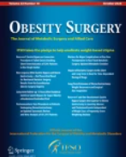

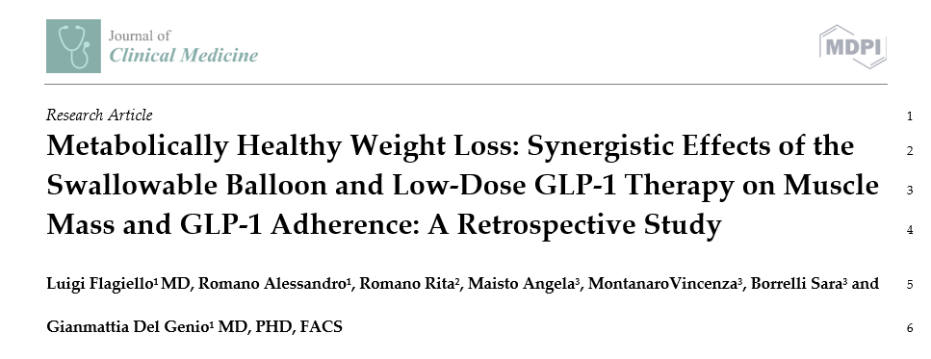
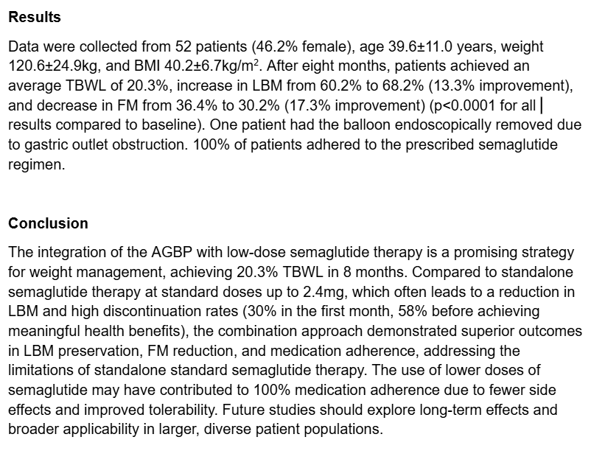
Dr. Luigi Flagiello, MD, Italy
University of Campania “L.Vanvitelli”- general and bariatric surgery
Ruesch Clinic - bariatric mininvasive division
METABOLICALLY HEALTHY WEIGHT LOSS: SYNERGISTIC EFFECTS OF THE SWALLOWABLE BALLOON AND LOW-DOSE GLP-1 THERAPY ON MUSCLE MASS AND GLP-1 ADHERENCE
SUBMITTED TO →

Slide 3
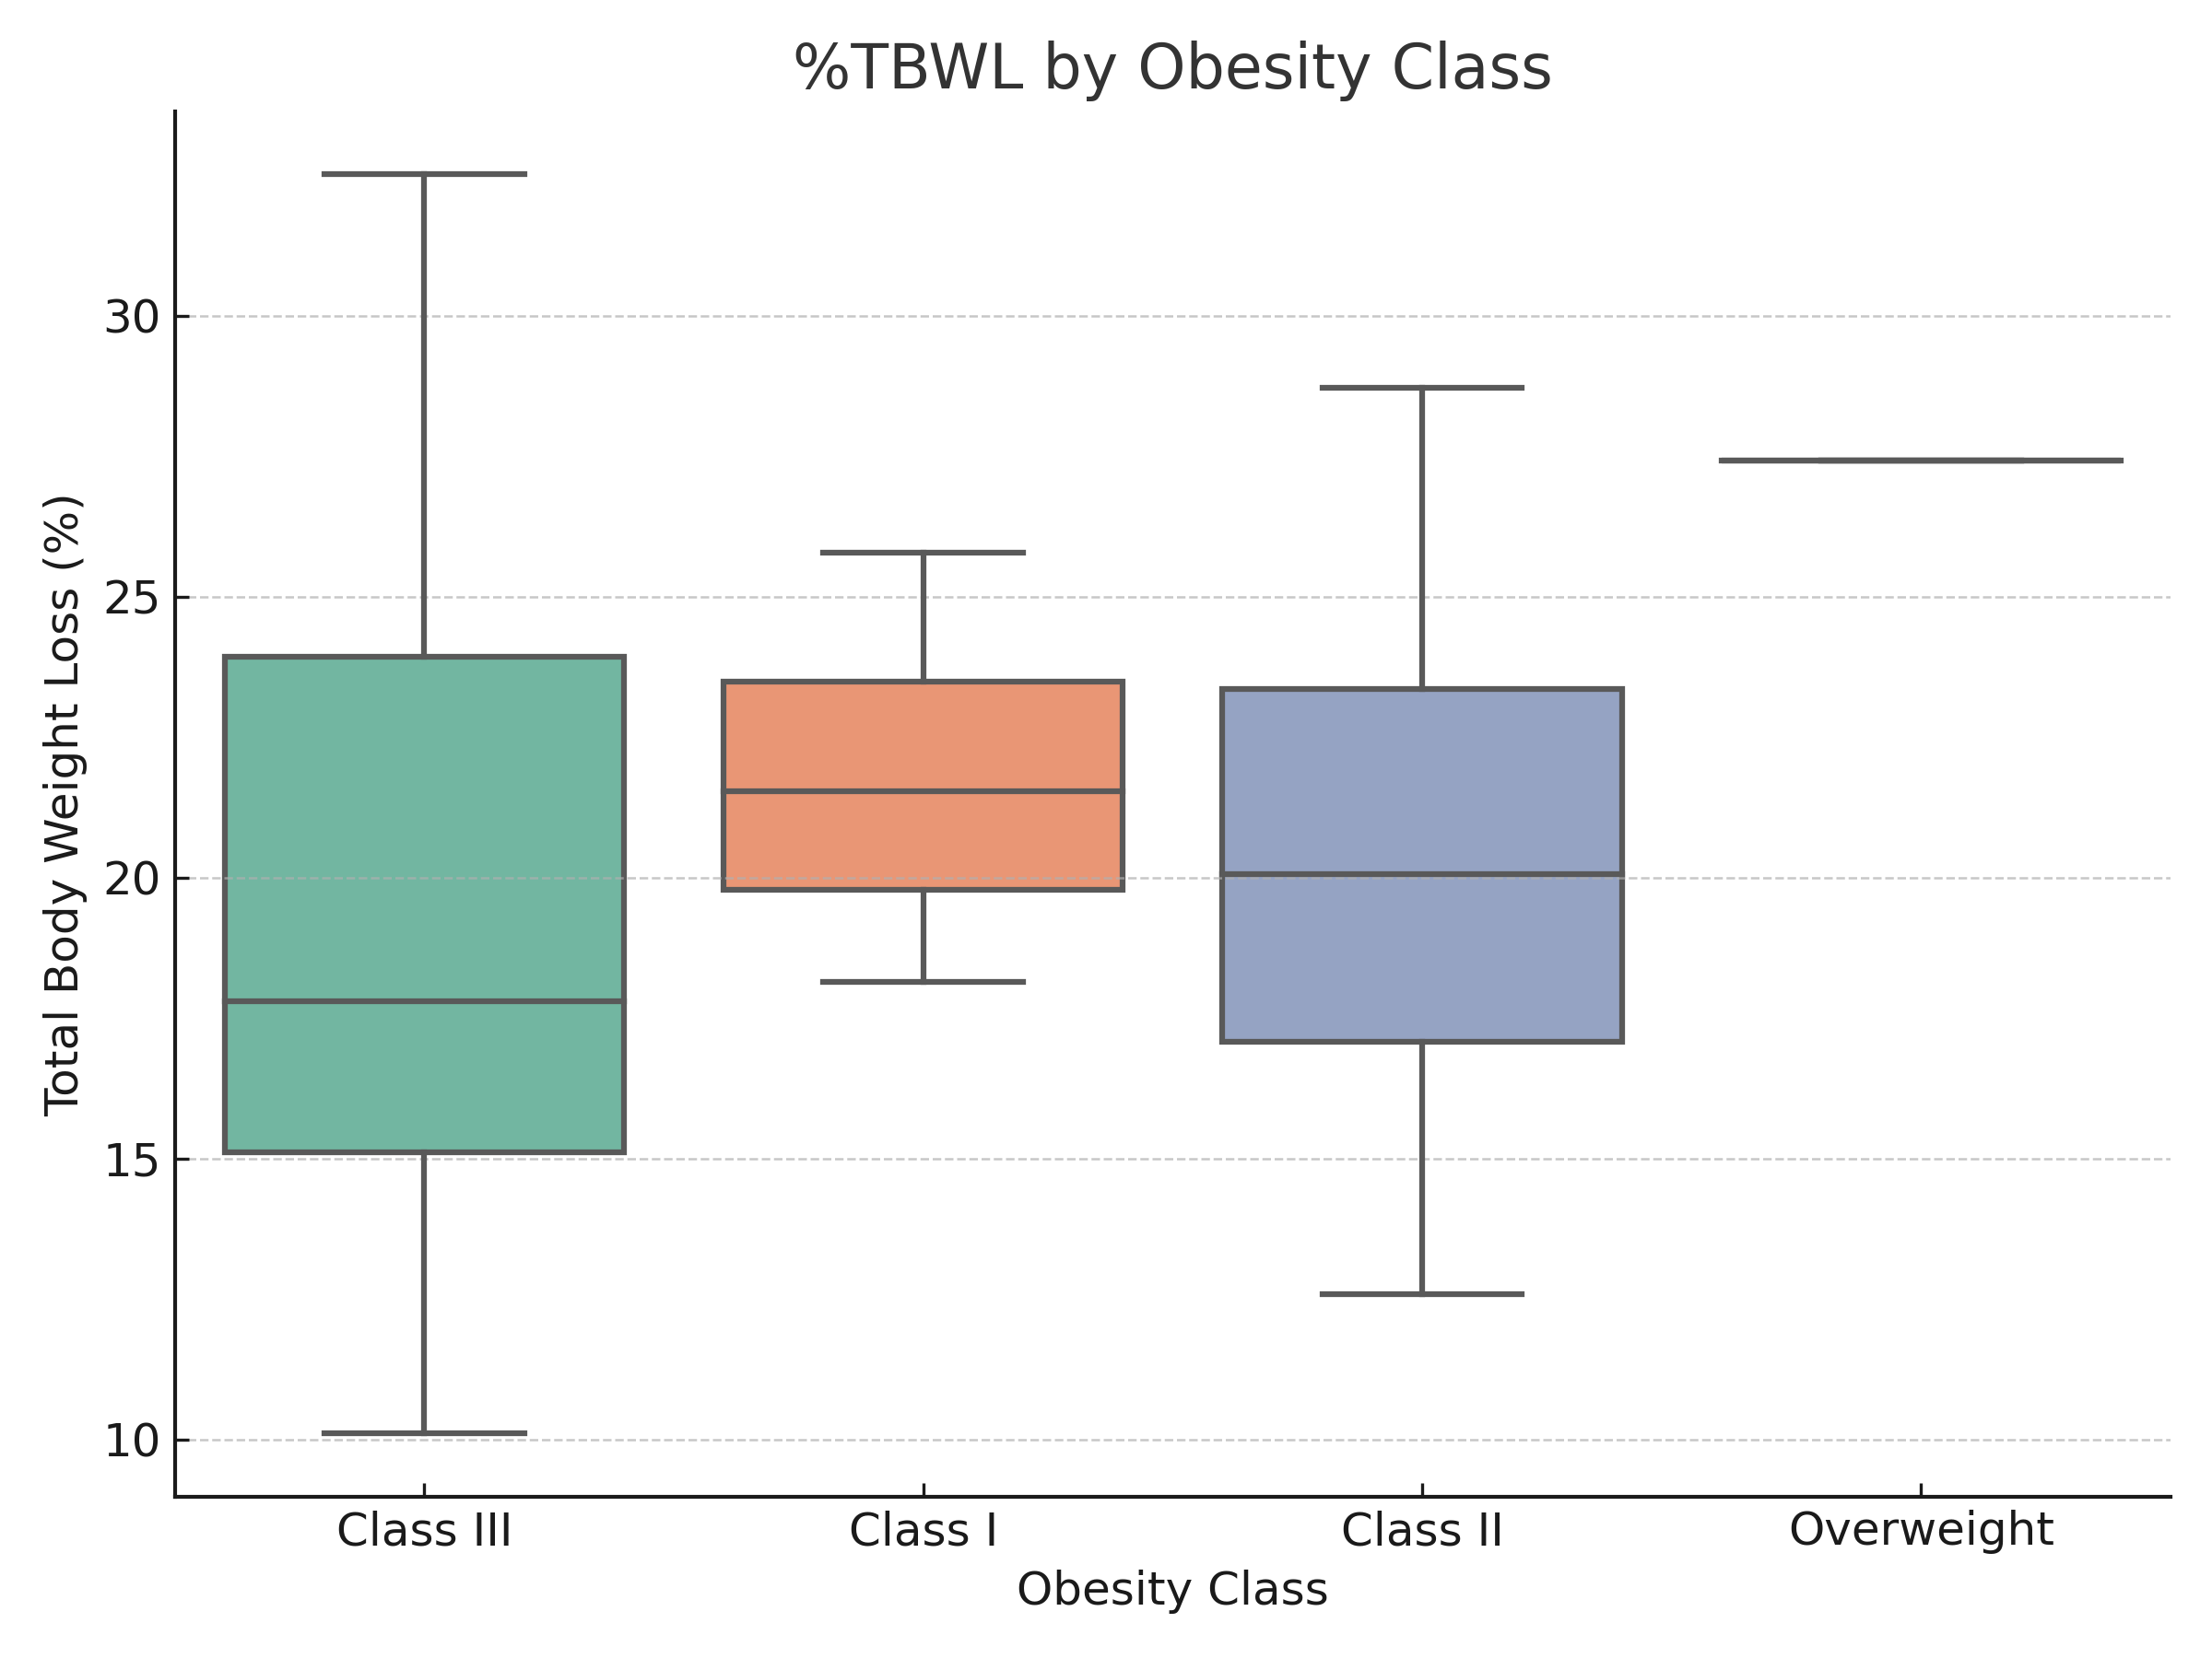
METABOLICALLY HEALTHY WEIGHT LOSS: SYNERGISTIC EFFECTS OF THE SWALLOWABLE BALLOON AND LOW-DOSE GLP-1 THERAPY ON MUSCLE MASS AND GLP-1 ADHERENCE
Patients with Class I obesity achieved higher average weight loss in percentage terms, with %TBWL often >22%.
Dispersion increases as you move up in class, indicating a more variable response in subjects with severe obesity, who in any case in terms of total weight have still achieved optimal results

Slide 4
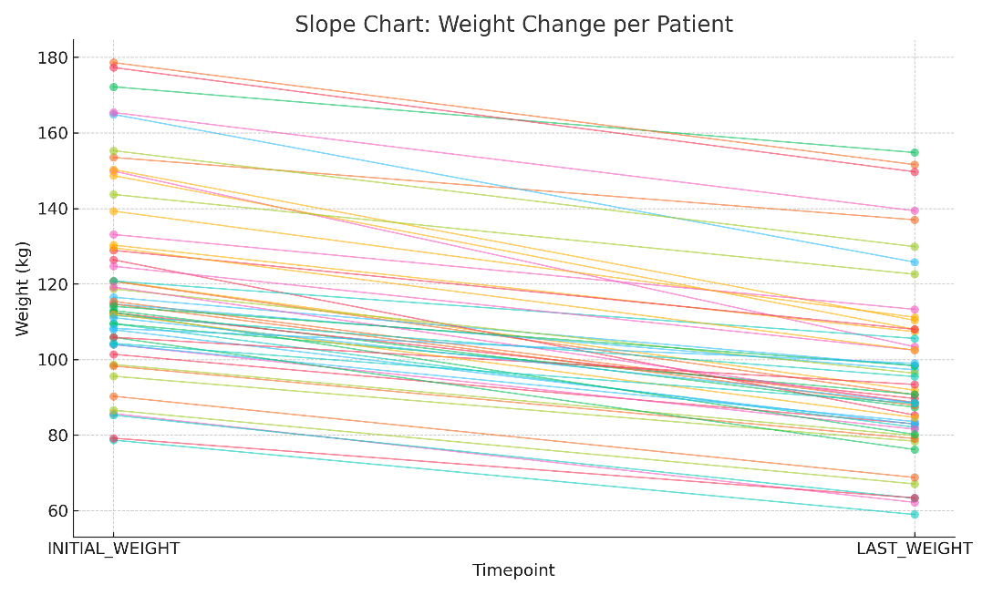
Patients with Class I obesity achieved higher average weight loss in percentage terms, with %TBWL often >22%.
Dispersion increases as you move up in class, indicating a more variable response in subjects with severe obesity, who in any case in terms of total weight have still achieved optimal results
In fact, regardless of the starting BMI, the loss in terms of kg has a linear and comparable trend in all enrolled patients

Slide 5
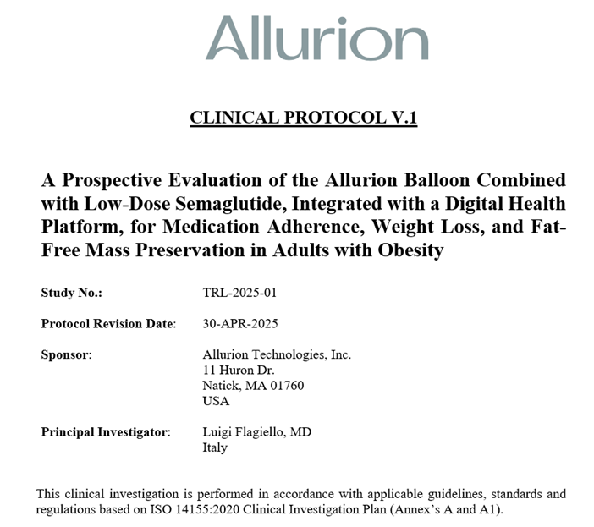
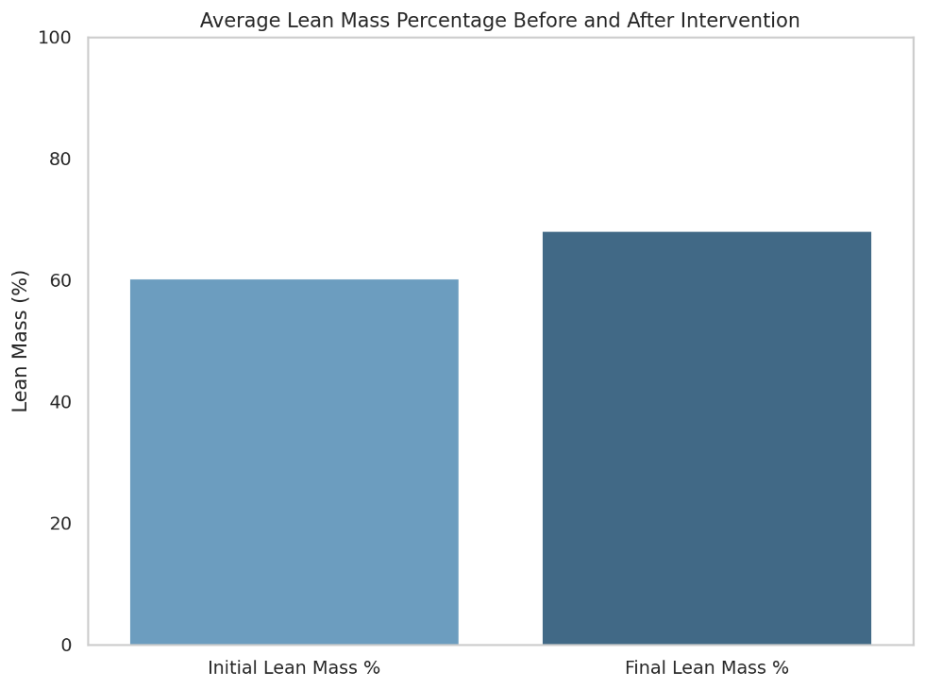

Patients with Class I obesity achieved higher average weight loss in percentage terms, with %TBWL often >22%.
Dispersion increases as you move up in class, indicating a more variable response in subjects with severe obesity, who in any case in terms of total weight have still achieved optimal results
APRIL 25
In fact, regardless of the starting BMI, the loss in terms of kg has a linear and comparable trend in all enrolled patients
One of the critical concerns in pharmacological obesity treatment—particularly with GLP-1 receptor agonists—is the loss of lean body mass (LBM).In this study, baseline lean mass averaged 60.6%, increasing significantly to 68.3% at follow-up – an absolute improvement of +7.7%.This contrasts sharply with standard semaglutide monotherapy at 2.4mg, which often results in 20–30% of weight loss being from lean mass.The AGBP combined with low-dose semaglutide (1.0mg max) offers a paradigm shift: effective fat loss while preserving—or even improving—LBM

Slide 6
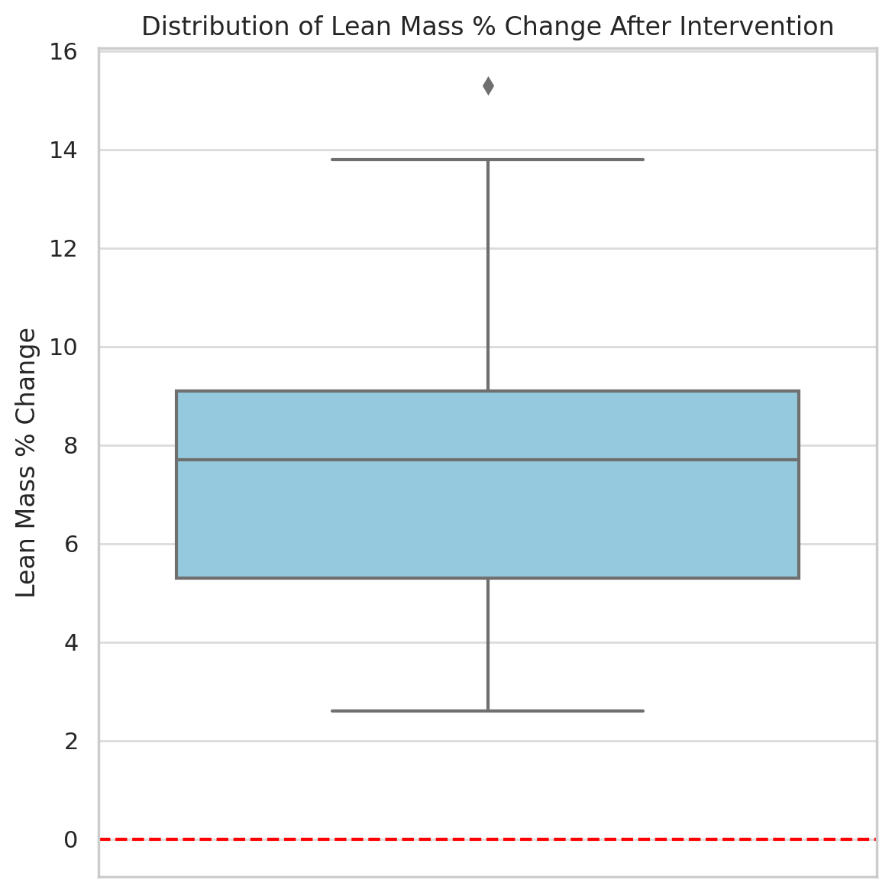
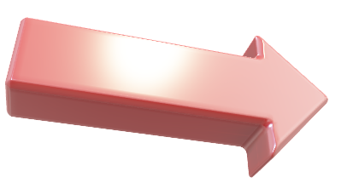
In fact, regardless of the starting BMI, the loss in terms of kg has a linear and comparable trend in all enrolled patients
APRIL 25
One of the critical concerns in pharmacological obesity treatment—particularly with GLP-1 receptor agonists—is the loss of lean body mass (LBM).In this study, baseline lean mass averaged 60.6%, increasing significantly to 68.3% at follow-up – an absolute improvement of +7.7%.This contrasts sharply with standard semaglutide monotherapy at 2.4mg, which often results in 20–30% of weight loss being from lean mass.The AGBP combined with low-dose semaglutide (1.0mg max) offers a paradigm shift: effective fat loss while preserving—or even improving—LBM
While the average LBM gain was +7.7%, it's crucial to assess individual responses.This boxplot illustrates the distribution of LBM % change across all patients. The majority experienced net gain, with outliers representing patients with minimal or no change.Notably, no patient experienced a loss in LBM, supporting the protective role of this combined therapy strategy.The clinical implication is clear: this protocol preserves metabolic tissue, enhancing long-term weight management and functionality.

Slide 7
One of the critical concerns in pharmacological obesity treatment—particularly with GLP-1 receptor agonists—is the loss of lean body mass (LBM).In this study, baseline lean mass averaged 60.6%, increasing significantly to 68.3% at follow-up – an absolute improvement of +7.7%.This contrasts sharply with standard semaglutide monotherapy at 2.4mg, which often results in 20–30% of weight loss being from lean mass.The AGBP combined with low-dose semaglutide (1.0mg max) offers a paradigm shift: effective fat loss while preserving—or even improving—LBM
APRIL 25
While the average LBM gain was +7.7%, it's crucial to assess individual responses.This boxplot illustrates the distribution of LBM % change across all patients. The majority experienced net gain, with outliers representing patients with minimal or no change.Notably, no patient experienced a loss in LBM, supporting the protective role of this combined therapy strategy.The clinical implication is clear: this protocol preserves metabolic tissue, enhancing long-term weight management and functionality.

Slide 8

NOW
APRIL 25
While the average LBM gain was +7.7%, it's crucial to assess individual responses.This boxplot illustrates the distribution of LBM % change across all patients. The majority experienced net gain, with outliers representing patients with minimal or no change.Notably, no patient experienced a loss in LBM, supporting the protective role of this combined therapy strategy.The clinical implication is clear: this protocol preserves metabolic tissue, enhancing long-term weight management and functionality.

Slide 9


APRIL 25
NOW
56 more patients treated with the same protocol from April (Follow up not yet completed)
(for now) SAME RESULTS ACHIEVED
In fact, regardless of the starting BMI, the loss in terms of kg has a linear and comparable trend in all enrolled patients

Slide 10


APRIL 25
NOW
56 more patients treated with the same protocol from April (Follow up not yet completed)
(for now) SAME RESULTS ACHIEVED
In fact, regardless of the starting BMI, the loss in terms of kg has a linear and comparable trend in all enrolled patients
To conclude
We all agree: GLP-1 receptor agonists like semaglutide have transformed the landscape of obesity treatment.
But in our integrated protocol, semaglutide is like Robin.
The loyal, essential sidekick who enhances outcomes, supports adherence, and protects lean body mass.
And Allurion? Allurion is Batman.
The main act. The one driving the transformation from day one.
Because in the end, let’s be honest
When you buy a ticket, you go to the cinema to see Batman, not Robin.
Our patients are the same.
They want results.
They want impact.
They want the hero.
And that’s why the combination works so well:
It’s not about choosing one hero.
It’s about building the right team to defeat obesity
the future is going there, like this congress’ title suggests

Slide 11

56 more patients treated with the same protocol from April (Follow up not yet completed)
(for now) SAME RESULTS ACHIEVED
NOW
APRIL 25
To conclude
We all agree: GLP-1 receptor agonists like semaglutide have transformed the landscape of obesity treatment.
But in our integrated protocol, semaglutide is like Robin.
The loyal, essential sidekick who enhances outcomes, supports adherence, and protects lean body mass.
And Allurion? Allurion is Batman.
The main act. The one driving the transformation from day one.
Because in the end, let’s be honest
When you buy a ticket, you go to the cinema to see Batman, not Robin.
Our patients are the same.
They want results.
They want impact.
They want the hero.
And that’s why the combination works so well:
It’s not about choosing one hero.
It’s about building the right team to defeat obesity.
the future is going there, like this congress’ title suggests
Thanks for the attention
In fact, regardless of the starting BMI, the loss in terms of kg has a linear and comparable trend in all enrolled patients

Slide 12
APRIL 25
NOW
Thanks for the attention
To conclude
We all agree: GLP-1 receptor agonists like semaglutide have transformed the landscape of obesity treatment.
But in our integrated protocol, semaglutide is like Robin.
The loyal, essential sidekick who enhances outcomes, supports adherence, and protects lean body mass.
And Allurion? Allurion is Batman.
The main act. The one driving the transformation from day one.
Because in the end, let’s be honest
When you buy a ticket, you go to the cinema to see Batman, not Robin.
Our patients are the same.
They want results.
They want impact.
They want the hero.
And that’s why the combination works so well:
It’s not about choosing one hero.
It’s about building the right team to defeat obesity
the future is going there, like this congress’ title suggests

